Slide 1
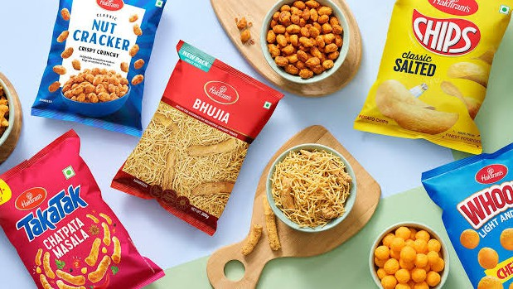


Slide 2
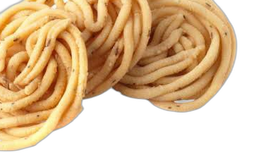
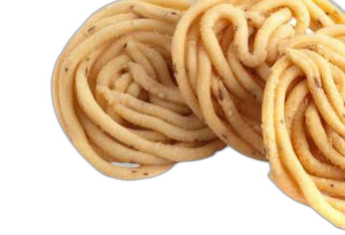
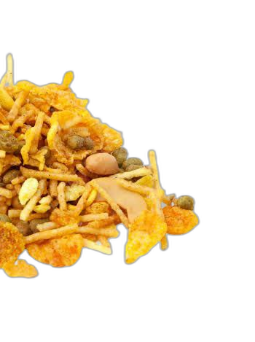
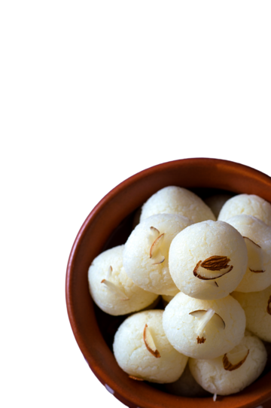
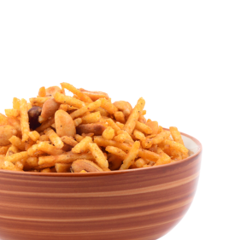
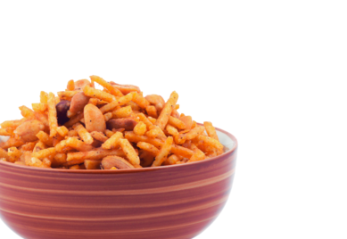
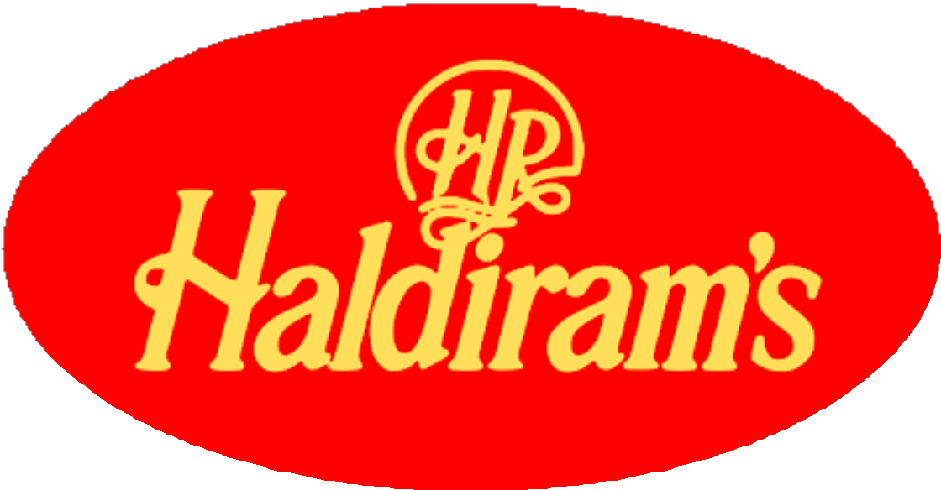
Digital Marketing
For

Slide 3
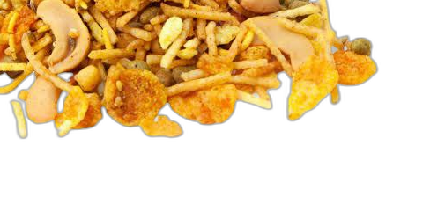

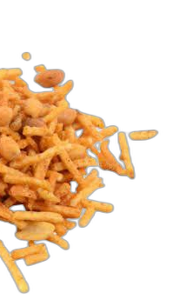
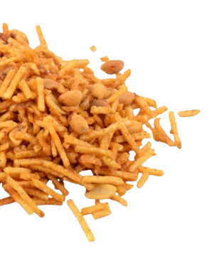

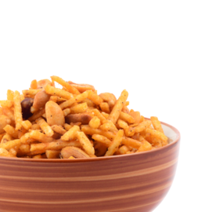
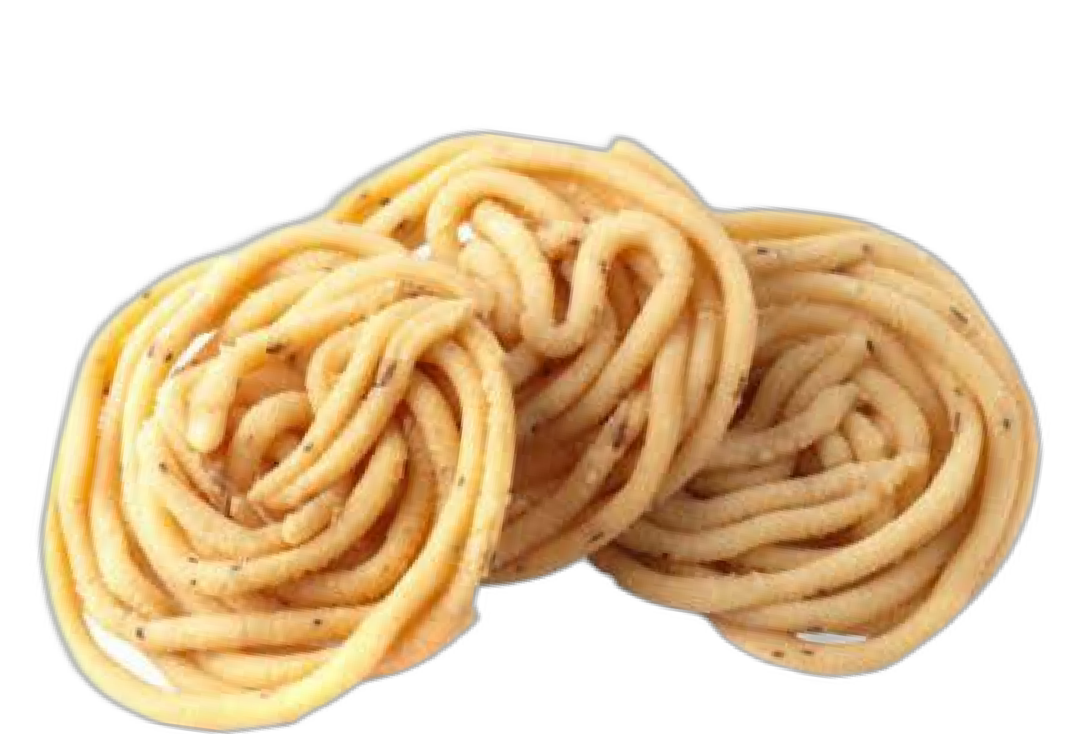
Team Members
M. Neeraj Kumar (Team Leader)
K.V.S Preetham
M. Pravallika
K. Mercy

Slide 4



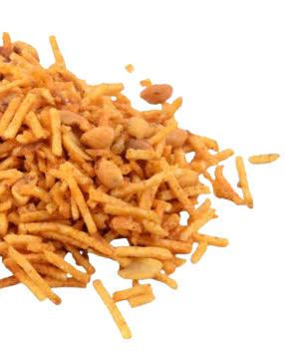





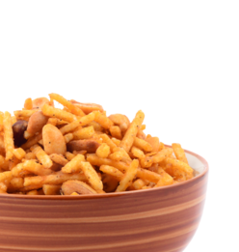
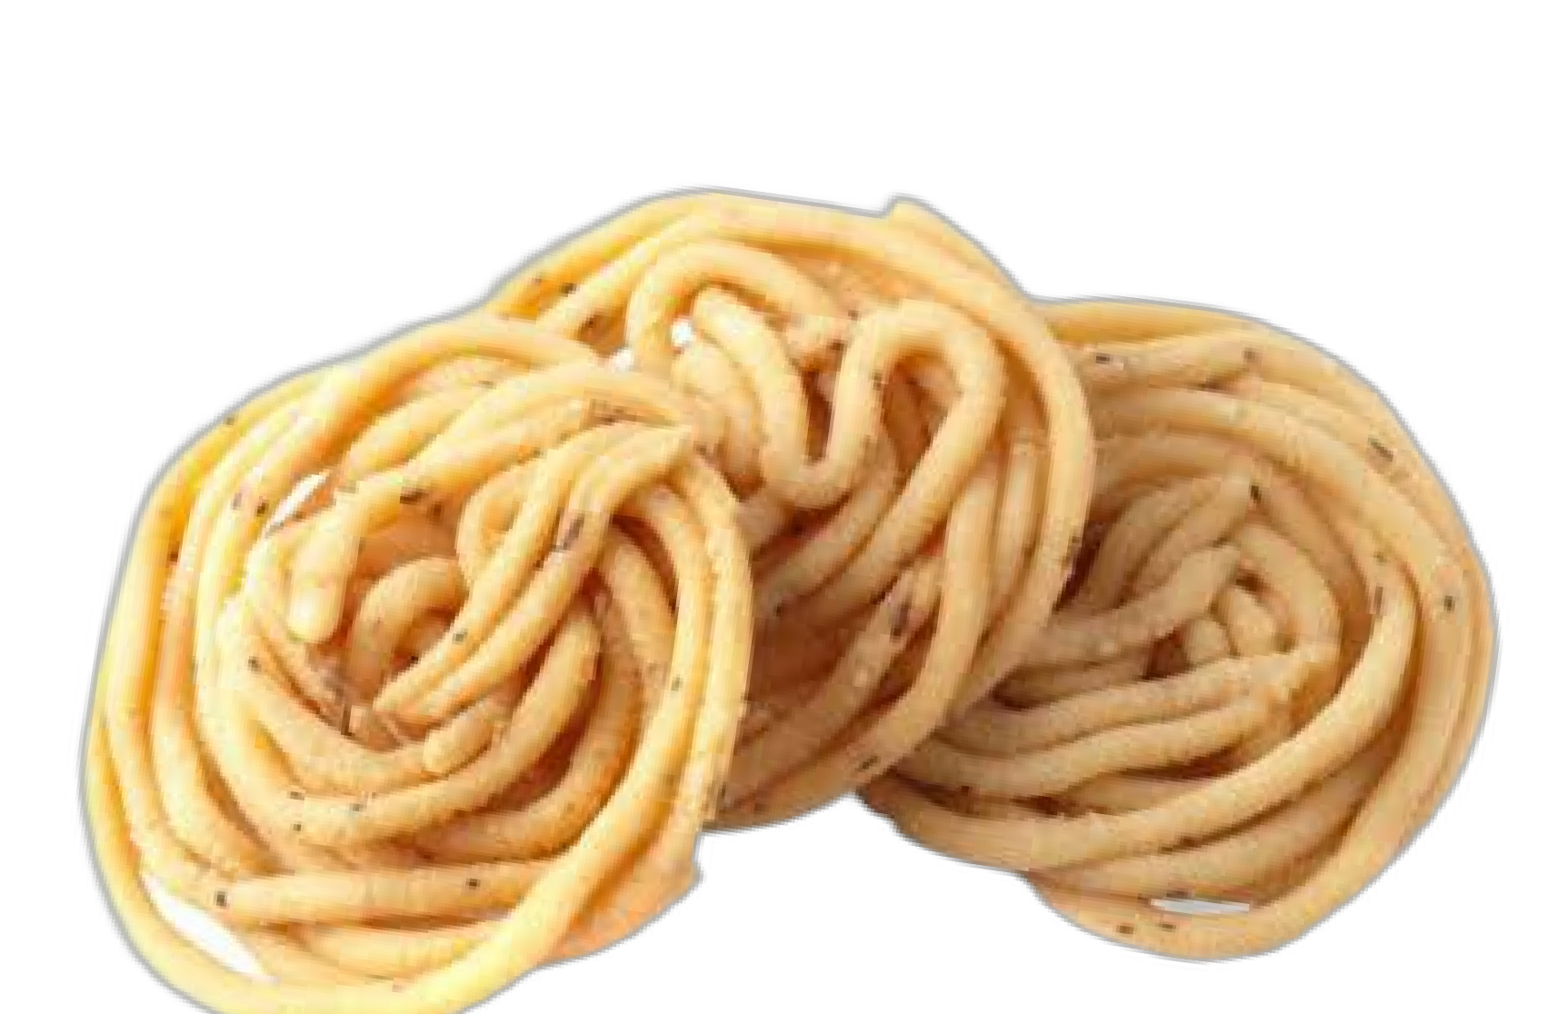
Comprehensive Digital Marketing for Haldiram’s
Brand Study, Competitor Analysis & Buyer Persona
SEO & Keywords Research
Content Ideas & Marketing Strategies Content Creation & Curation

Slide 5
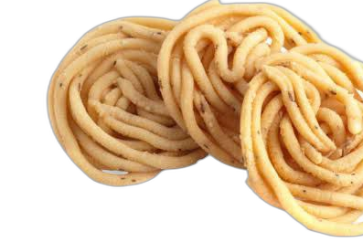
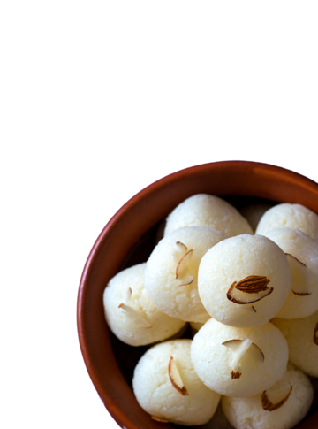
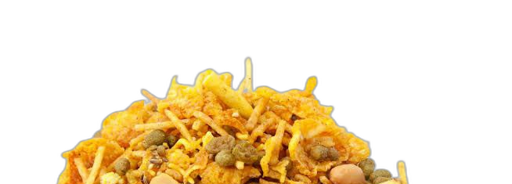
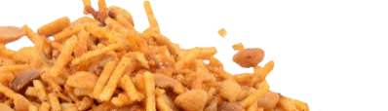
1. Brand Study, Competitor Analysis &
Buyer Persona

Slide 6

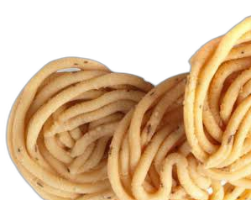
Research Brand Identity
Since 1937, Haldiram’s has been a symbol of taste, tradition, and trust evolving into India’s most beloved brand for snacks and sweets.
With an extensive product portfolio including authentic Indian sweets, crispy savories, frozen delights, and ready-to-eat meals Haldiram’s masterfully blends heritage with innovation, catering to evolving consumer preferences.
The brand’s unwavering commitment to quality and taste has established its presence in over 80 countries, with growing demand in the US, UK, and the Middle East.
Rooted in tradition, driven by innovation Haldiram’s is more than just food; it’s an experience that unites generations

Slide 7

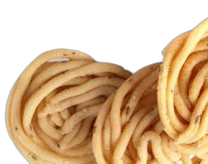
Competitor Analysis
Major Competitors: Bikaji, Bikanervala, Balaji Wafers, ITC Bingo, and PepsiCo (Lay’s).
Insights:
✔ Competitors like Bikaji and Bikanervala are investing in aggressive D2C (Direct-to- Consumer) strategies, strengthening their e-commerce platforms.
✔ Balaji Wafers and ITC Bingo are leveraging youth-centric branding, focusing on
affordable pricing and wide flavor variety to attract younger audiences.
✔ The rise of health-conscious snacking (e.g., baked snacks, millet-based snacks) is pushing brands to reformulate products with lower oil and sodium content.

Slide 8
Competitor Analysis -Strategy Focus Areas
D2C Strategy Youth-Centric Branding Health-Focused Innovation
20
Strategy Focus (0-20)
15
10
5
0
Bikaji
Bikanervala
Balaji Wafers
Competitors
ITC Bingo
PepsiCo (Lay's)

Slide 9
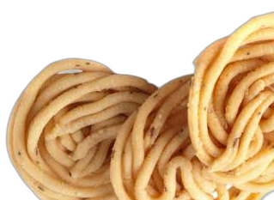
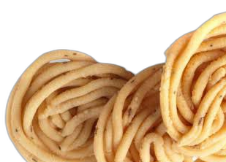
Buyer’s/Audience Persona
Traditional Snack Lovers: Indian families, aged 30+, preferring authentic flavors, often purchase in bulk.
Health-Conscious Consumers: Young professionals (18-35) looking for low-fat, high-protein snacks like baked bhujia or roasted nuts.
Festive & Gift Buyers: Individuals purchasing premium hampers for Diwali, Rakhi, and weddings, often seeking customizable gifting options.
NRI & Global Market: Indians abroad seeking authentic, preservative-free Indian snacks, especially during cultural festivals.

Slide 10
Haldiram’s Buyers & Audience Persona Distribution
Festival & Gifting Segment 20%
Traditional Indian Snack Lover 35%
Millennial & Gen Z Snackers 20%
Health- Conscious Consumer 25%

Slide 11
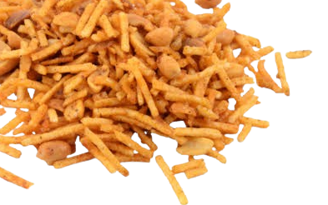
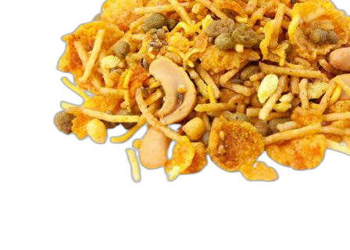
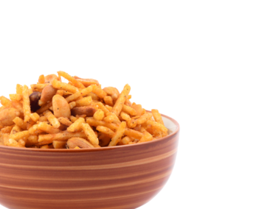
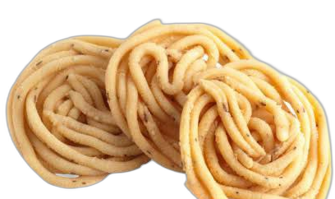
2. SEO & Keyword Research

Slide 12

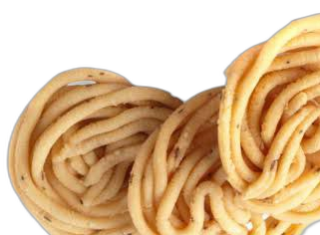
SEO Audit
Current Website Issues:
❌ Slow loading speed – High bounce rate due to delayed page responses.
❌ Missing meta descriptions & alt texts – Reducing discoverability in search engines.
❌ Poor mobile responsiveness – Suboptimal experience for smartphone users, impacting conversion rates.
❌ Weak internal linking strategy – Resulting in lower engagement per session.

Slide 13
SEO Growth Projection for Haldiram’s
35000
30000
Organic Traffic (Visitors)
25000
20000
15000
10000
5000
0
Month 1
Month 2
Month 3
Month 4
Month 5
Month 6
Months

Slide 14
SEO Audit: Website Issues Breakdown
Missing meta description & alt texts 25%
Weak internal linking strategy 20%
Slow loading speed 30%
Poor Mobile responsiveness 25%

Slide 15

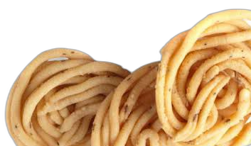
Keyword Research
✔ High-volume Keywords: "Haldiram snacks online," "buy Haldiram sweets," "best Indian namkeen."
✔ Long-tail Keywords: "Healthy Indian snacks for diet," "Diwali gift hampers Haldiram," "low-fat bhujia alternative."
✔ Trending Keywords: "Millet snacks India," "best gluten-free namkeen," "Diwali sweets combo online."

Slide 16
SEO Keyword Research for Haldiram’s
Haldiram Snacks Online
Buy Haldiram Sweets Healthy Indian Snack Diwali Gift Hampers Best Namkeen Brand
0 2000 4000 6000 8000 10000
Search Volume (per Month)
Keyword’s

Slide 17

On-Page Optimization
✔ Improve website speed & mobile UX – Implement lazy loading and optimize images for faster performance.
✔ Add structured data (schema markup) – Enabling rich snippets for better Google rankings.
✔ Update SEO-friendly product descriptions – Using power words like
"authentic," "premium," and "healthy choice."
✔ Enhance blog strategy – Introduce informative articles like “Best Indian Snacks for Weight Loss” and “Regional Indian Snacks You Must Try.”

Slide 18
Importance of On-Page Optimization Factors
Content Quality Keyword Optimization
Meta Tags URL Structures Page Speed
Mobile Friendliness Internal Linking Image Optimization
User Experiencen (UX) Scheme Markup
On-Page Seo Factors
0 2 4
Importance Score (1-10)
6
8
10

Slide 19
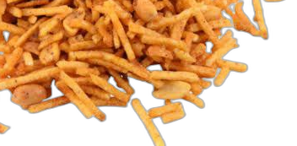
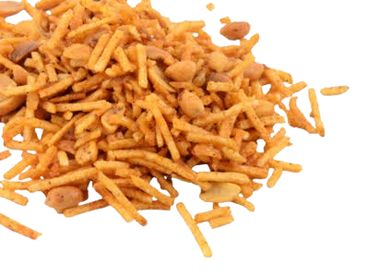


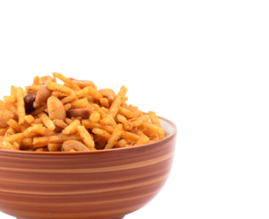
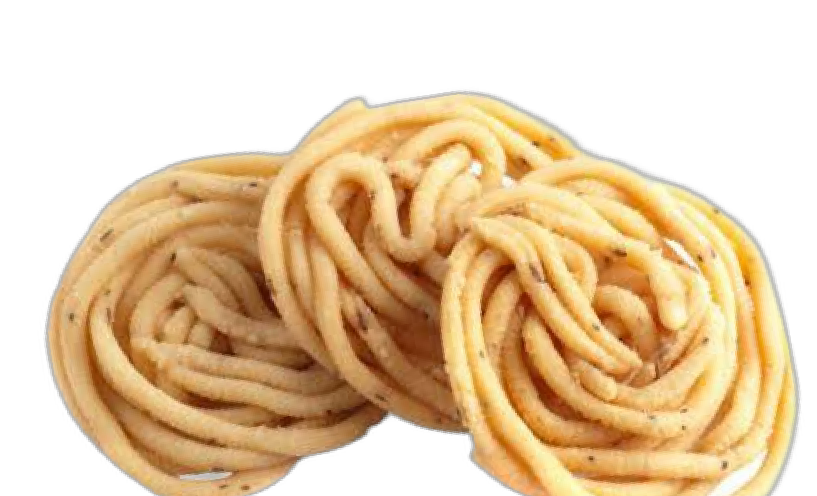
3. Content Ideas & Marketing Strategies

Slide 20

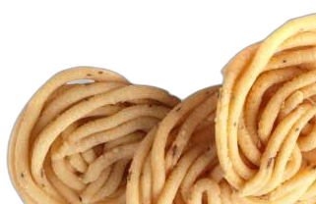
Content Idea Generation & Strategy
✔ Festive & Seasonal Content – “Top 5 Diwali Gift Hampers with Haldiram’s,” “Ramzan Special Sweets from Haldiram’s.”
✔ Recipe & How-To Videos – “Quick Snacks Using Haldiram’s Bhujia,” “5-Minute Chaat Recipes with Haldiram’s.”
✔ Behind-the-Scenes (BTS) – “How Haldiram’s Ensures Freshness in Every Pack,” “A Day Inside
a Haldiram’s Factory.”
✔ User-Generated Content (UGC) – “Customer stories on nostalgic Haldiram moments,” “Instagram challenges with #HaldiramCravings.”
✔ Sustainability Campaigns – “Eco-Friendly Packaging Initiatives,” “Reducing Plastic Use in Snack Packaging.”

Slide 21
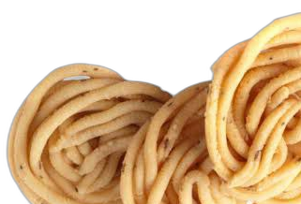
Marketing Strategies
✔ Influencer Collaborations – Partner with food bloggers, chefs, and fitness influencers promoting Haldiram’s healthier snack options.
✔ E-commerce Promotions – Flash sales on Amazon, Flipkart, BigBasket, and Swiggy Instamart to drive urgency-based purchases.
✔ Localized Ads – Digital campaigns in Hindi, Tamil, Bengali, and Telugu, targeting regional consumers.
✔ Referral & Loyalty Programs – Rewarding repeat customers with discounts and exclusive early access to new products.

Slide 22
Comparison of Marketing Strategies for Haldiram’s - 1
Influencer Collaborations
Marketing Strategies
E-commerce Promotions
Localized Ads
Referral & Loyalty Programs
0
5 10
Score (out of 20)
15
20

Slide 23
Comparison of Marketing Strategies for Haldiram’s - 1
Market Penetration
Marketing Strategies
Product Development
Market Expansion
Competitive Pricing
0
5 10
Score (out of 20)
15
20

Slide 24
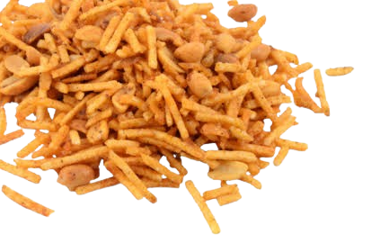
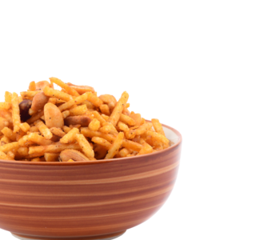
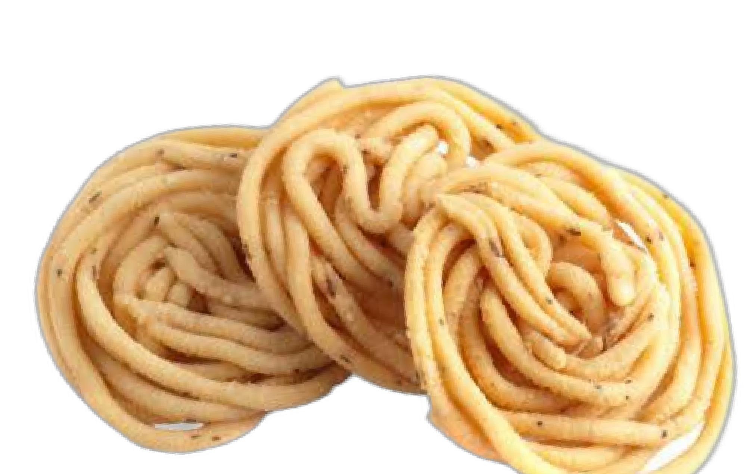
4.Content Creation & Curation

Slide 25

Post Creation
✔ Engaging Instagram
Reels
Create
featuring
street-style
food
using
using
Haldiram’s products –
Haldiram’s snacks. Use trending music, fast cuts, and influencer
quick, mouth-watering recipes
collaborations to boost engagement.
✔ Festival-themed posts & interactive polls – Celebrate festivals with vibrant snack combos, contests, and user polls like “Which Haldiram’s snack is your Holi favorite?” to spark engagement.
✔ Regional meme marketing tapping into pop culture trends – Use viral dialogues, cricket moments, and regional humor to make Haldiram’s snacks more relatable and shareable.

Slide 26
Post Creation
✔ Recipe Challenges – Host a “Snack Attack” challenge where users create recipes using Haldiram’s products and tag your account. Offer prizes to boost participation.
✔ Snack Trivia & Fun Facts – Post engaging snack-related trivia or interesting facts about Haldiram’s legacy, products, and innovations.
✔ Collaboration with Food Bloggers – Partner with regional food creators for authentic reviews and creative snack recipes. Collaborations drive credibility and reach.
✔ Festive Snack Hampers – Promote limited-edition festive hampers for Diwali, Holi, or regional festivals. Use vibrant visuals and emotional storytelling to highlight gifting options.

Slide 27
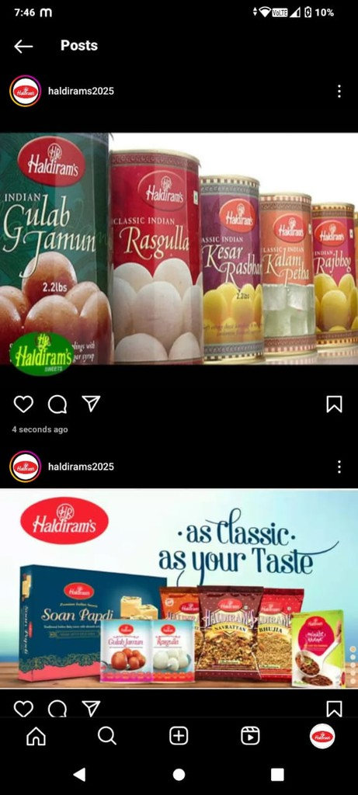
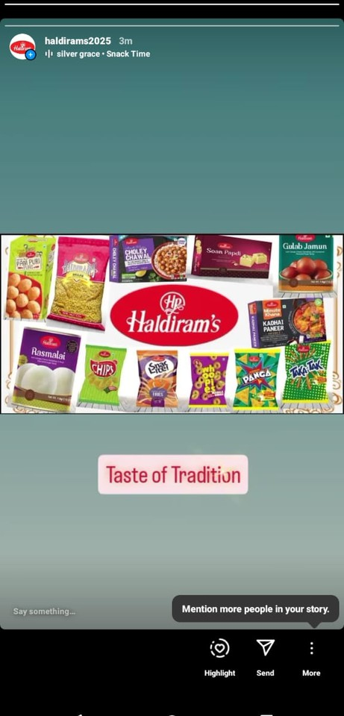
Instagram Post
https://www.instagram.com
/haldirams2025? igsh=bmlkczJ0YWxnbXdmh ttps://www.instagram.com/ haldirams2025? igsh=bmlkczJ0YWxnbXdmt

Slide 28


Designs/Video Editing
✔ Festive Banners & Promo Videos – Eye-catching visuals showcasing Haldiram’s festive collections with vibrant designs and engaging taglines.
✔ Short-form Content – Quick, engaging videos for YouTube Shorts, Reels, and Stories featuring recipes, unboxings, and snack moments with trending music.
✔ Stop-Motion Animations – Creative clips highlighting Haldiram’s product quality, ingredients, and authenticity in a fun, engaging way.

Slide 29
Expected Social Media Engagement Growth for Haldiram’s
Current Followers Expected Followers
20
15
10
5
0
Followers
Instagram
Facebook Twitter You Tube
Social Media Platforms
LinkedIn

Slide 30
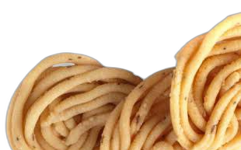
Social Media Ad Campaigns
✔ Facebook & Instagram Ads – Eye-catching creatives promoting new product launches and limited-edition Haldiram’s snacks with compelling CTAs.
✔ YouTube Ads – Short 10-15 second recipe tutorials featuring Haldiram’s snacks to engage food lovers.
✔ Google Display Ads – Retargeting visitors who browsed Haldiram’s website but didn’t make a purchase, reminding them of their favorite snacks.
✔ Pinterest & Twitter Ads – Targeting recipe enthusiasts and festival shoppers with snack ideas and festive food inspiration.

Slide 31
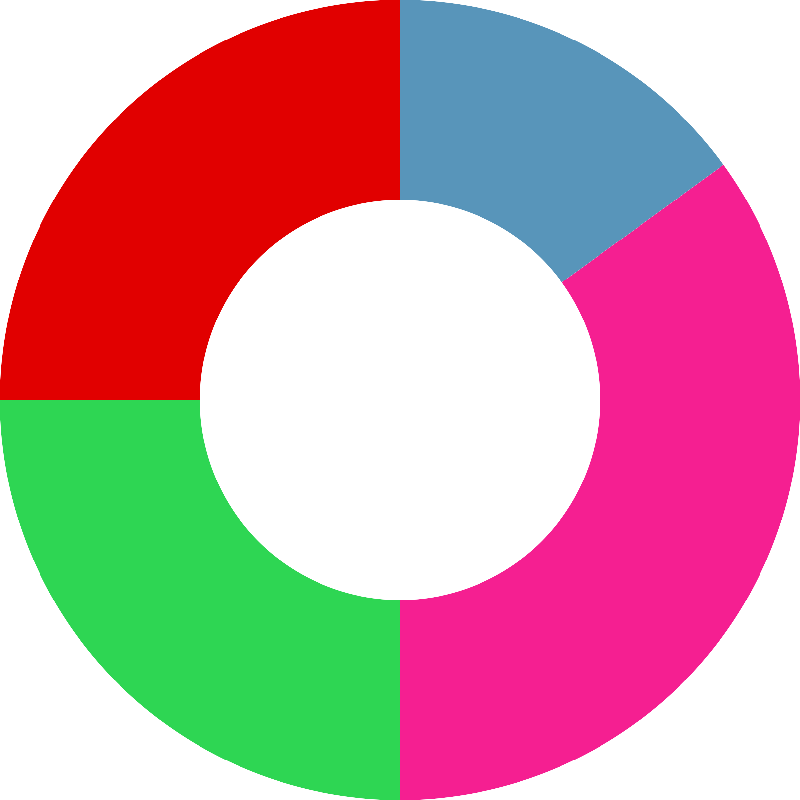
Focus Distribution in Social Media Ad Campaigns
Pinterest & Twitter Ads
15%
You Tube Ads 25%
Facebook & Instagram Ads 35%
Google Display Ads 25%

Slide 32
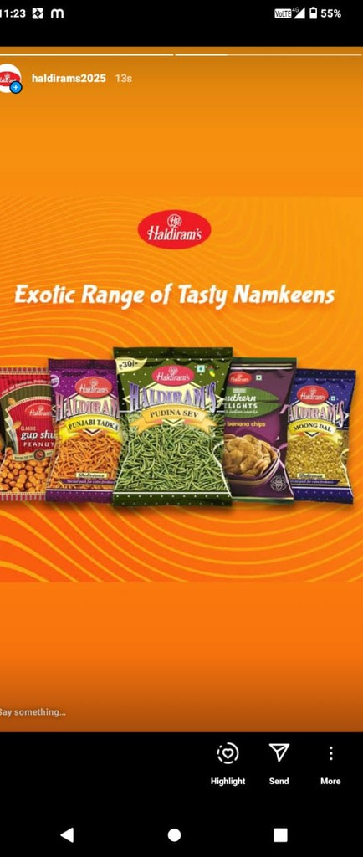
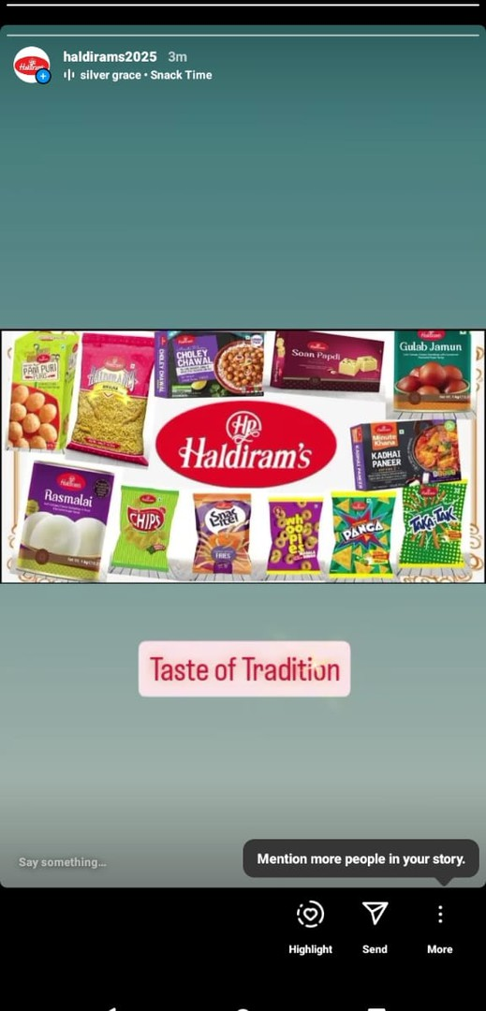
Instagram Stories
https://www.instagram.com
/haldirams2025? igsh=bmlkczJ0YWxnbXdmh

Slide 33
Email Ad Campaigns
✔ Personalized Discounts & Festival Alerts – Targeted offers and festive deals to encourage repeat purchases.
✔ Cart Abandonment Emails – Reminders with exclusive discounts to bring back potential buyers and recover lost sales.
✔ Subscription Snack Boxes – Special promotions for loyal customers, offering curated Haldiram’s snack boxes on a subscription basis.

Slide 34
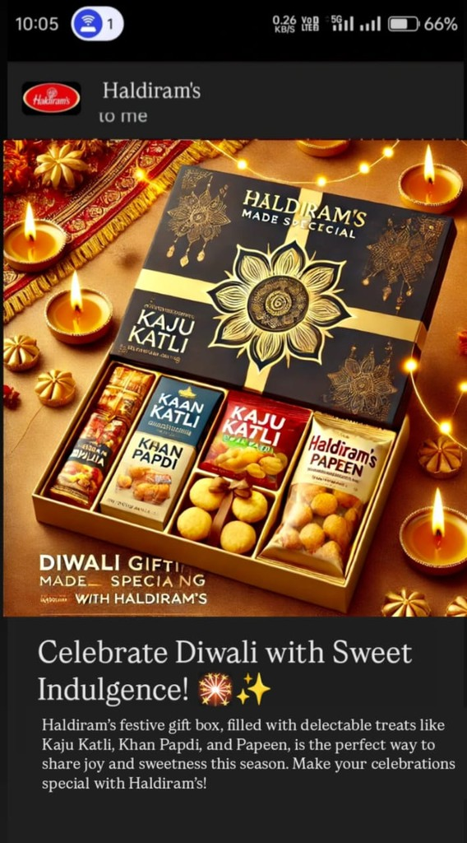
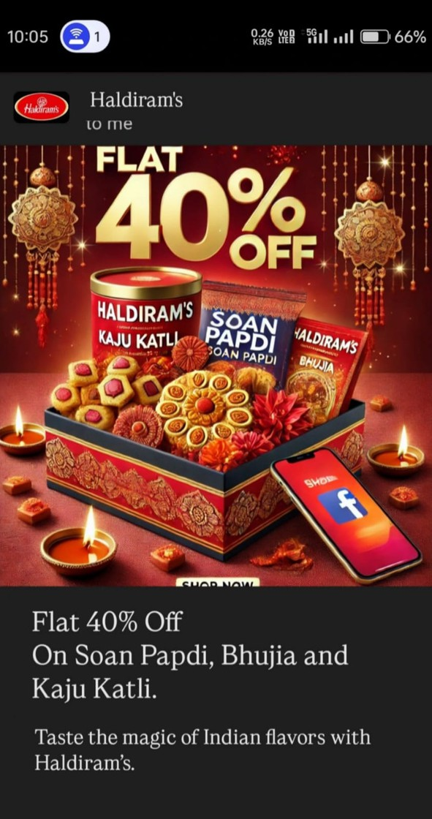
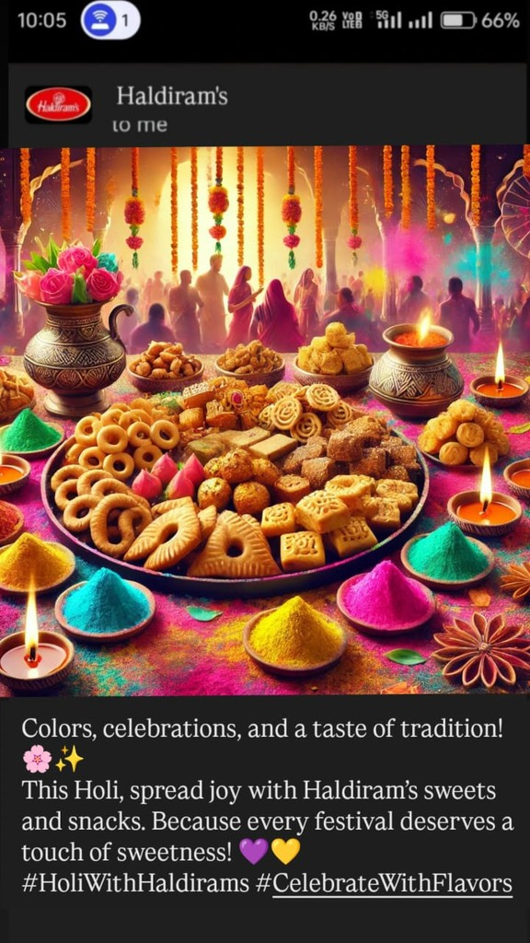
Email Marketing

Slide 35
Conclusion
Haldiram’s digital marketing strategy is designed to drive visibility, engagement, and sales through SEO, targeted ads, and influencer collaborations. Optimized retargeting, cart abandonment emails, and personalized discounts will help boost conversions and customer retention. Festival promotions, interactive content, and subscription snack boxes will strengthen brand recall and loyalty.
By leveraging data-driven insights and continuously optimizing campaigns, Haldiram’s can achieve sustainable growth, ensuring a 20-25% increase in online sales. With a strong focus on customer experience and market trends, the brand will maintain its leadership in the competitive snack industry while expanding its digital footprint.

Slide 36
Digital Marketing Budget Breakdown For Haldrim’s
Influcencer Collaboartions
17%
Social Media Ads 22%
Email Marketing 6%
Design & Video 11%
SEO & Content 11%
Google Ads 22%
E-commerce Promotion 11%

Slide 37
Expected Outcomes
✔ 30-40% Increase in Organic Traffic – Focus on SEO improvements, including keyword optimization, high-quality blog content, and backlink strategies.
✔ Higher Conversion Rates – Refine ad targeting with audience segmentation and retargeting to turn more visitors into buyers.
✔ Stronger Brand Recall – Leverage influencer collaborations and interactive content (quizzes, polls, and UGC campaigns) to make Haldiram’s more memorable.
✔ 20-25% Growth in Online Sales – Drive e-commerce success with limited- time festive discounts, bundle offers, and seamless checkout experiences

Slide 38

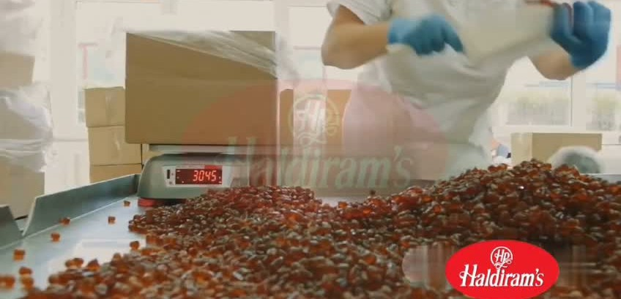
Video

Slide 39
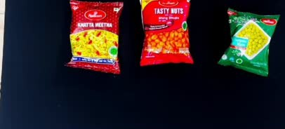
Video

Slide 40






Thanking You!

